Slide 1
Electron Quiz
Session 5

Slide 2
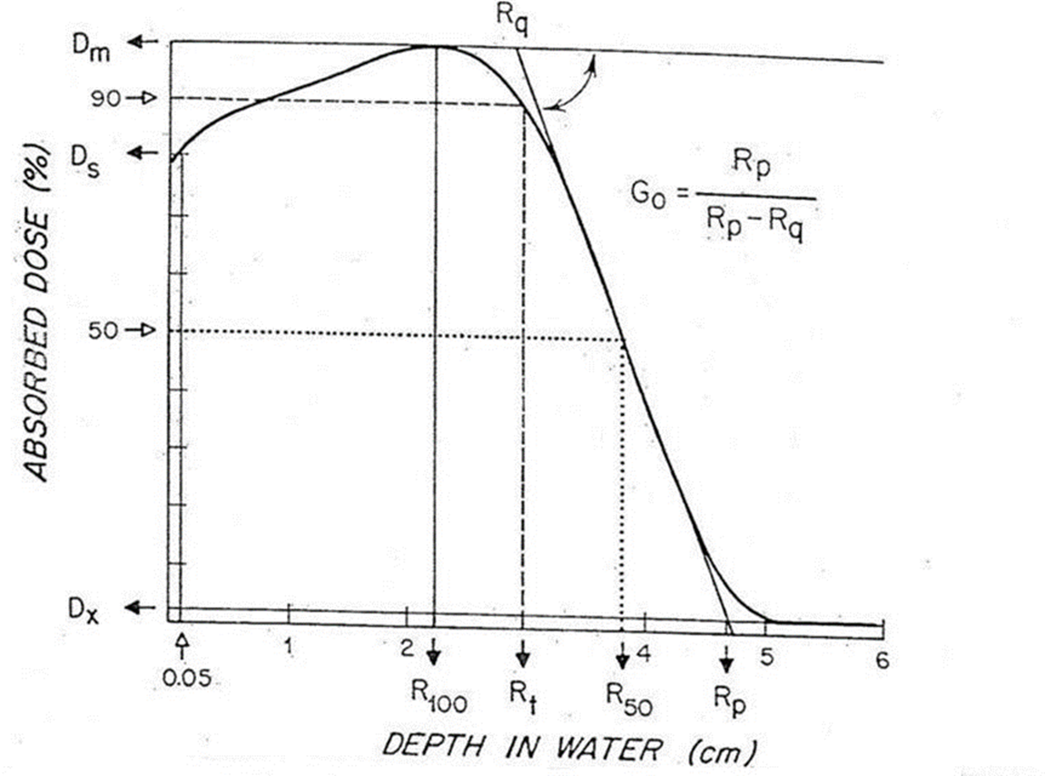

Q1
Define missing terms.
What are their rules of thumb, as related to energy?

Slide 3
Q1
Define missing terms.
What are their rules of thumb, as related to energy?
R₉₀(cm)=E/4 (=E/3.2)
R₈₀(cm)=E/3 (=E/2.8)
R_{P}(cm)=E/2

Slide 4
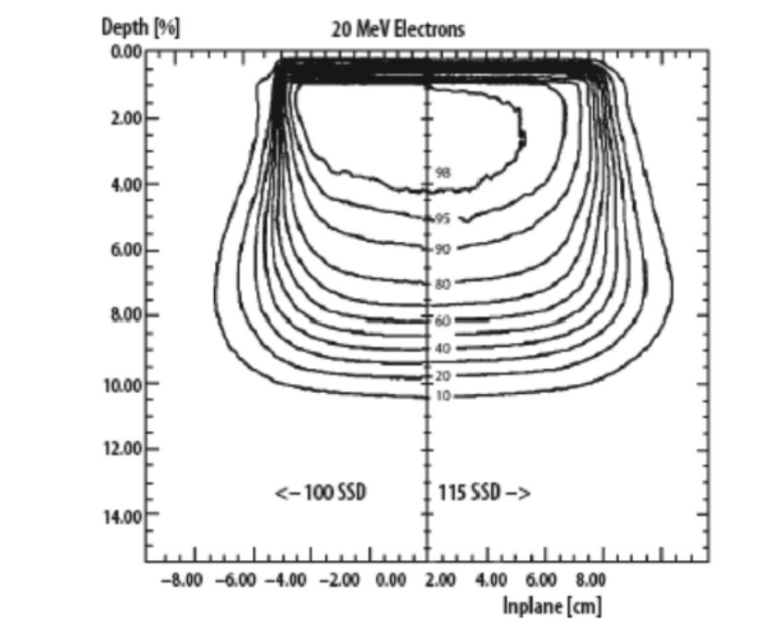
Q2
What is the difference between A and B?
What is the energy of this beam?
A
B

Slide 5
Q3
You are treating a 1 cm thick lesion in the lip. You have 0.5 cm of bolus. You have a 6 MeV beam.
How much energy will be left after the lesion?
What could you do for OAR sparing?

Slide 6
Q3
You are treating a 1 cm thick lesion in the lip. You have 0.5 cm of bolus. You have a 6 MeV beam.
How much energy will be left after the lesion?
What could you do for OAR sparing?
RULE OF THUMB:
Blocking thickness
t_{PB}=E/2+1 mm
t_{cerr}=t_{PB}(1+20%) mm

Slide 7
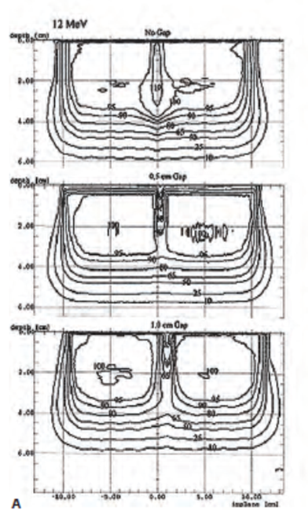
Q4
A
What is the difference between A, B, C?
Which setup would we use clinically?
B
C

Slide 8
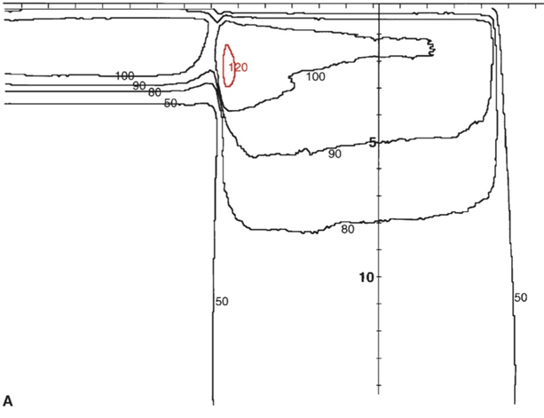
Q5
What treatment site may you see this beam arrangement?
Describe the reason for the hot spot location.

